Slide 1



A deeper dive into telecommuting behavior using multiple longitudinal data sources
Mark Bradley

Slide 2


Research Method
Used IPUMS to extract American Communities Survey (ACS) PUMS microdata from 2006 to 2023, and to extract American Time Use Survey (ATUS) data from 2006 to 2024. Saved many hours of potential work!
(Also used 2024 ACS 1-year aggregate tables released last week)
Carried out descriptive analysis to examine changes in how many people were working from home and who those people were, and to compare the two data sources.
An extension of the presentation “A Deep Dive into the Increase in Working from Home and Related Effects on Equity and Travel” at the 2023 TRB Conference on Innovations in Travel Analysis and Planning.

Slide 3
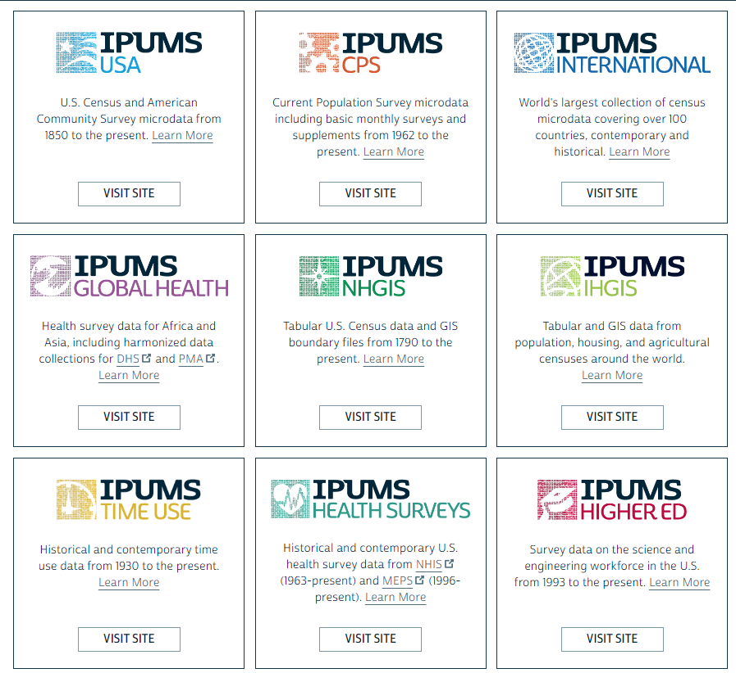


has more than just ACS data and ATUS data….
(www.ipums.org)

Slide 4


Pros and Cons of Using ACS PUMS vs. ATUS
ACS
The ACS data and methods are quite consistent from year to year
A huge data set (~1 million households/year, a 1 % sample)
A wide variety of variables – including some on commuting behavior
Just a single question on working from home as the usual “commute mode” (does not capture hybrid teleworking well)
ATUS
The ATUS data and methods are quite consistent from year to year
A full day of activity and travel durations, including data on physical activities
A limited sample size (8K to 14K adults per year, shrinking over time)
No detailed data on spatial locations (not crucial for this analysis)

Slide 5

National trend in usual mode to work – from ACS
PRE-COVID
The percent of US workers working mainly from home rose from 3.9% in 2006 to 5.7% in 2019 (a 46% increase relative to 2006).
Private vehicle (~91%), transit (~5.3%) and walk/bike (~3.5%) share were very stable.
“POST-COVID”
The percent of US workers working mainly from home rose from 5.7% in 2019 to 17.9% in 2021 (a 213% increase relative to 2019) and stable at around 13-14% in 2023 and 2024.
Excluding work from home, transit commute mode share dropped from ~5.3% to ~3.0% and has risen back to ~4.3% while…
Walk + bike mode share has stayed at ~3.5%

Slide 6
National trend in telecommuting – from ATUS and ACS
ATUS DEFINITIONS
A “workday” is 180+ minutes in any work activity.
A “telework day” has all work minutes spent at home, otherwise it is a “commute day”.
ATUS
COMPARISON
The two data sets and definitions give similar percentage until 2020.
After 2020, ATUS is much higher---presumably due to hybrid telework that is not “the usual mode” in ACS.
After dropping off in 2022 and 2023, ATUS shows it stable at 20% in 2024.

Slide 7
Trends by income group from ACS PUMS and ATUS

Slide 8
Trends by age group from ACS PUMS and ATUS

Slide 9
Trends by gender& age of children from ACS PUMS and ATUS

Slide 10
The ATUS has data on duration of walking, biking, and other exercise activities
5% less >

Slide 11
Is the amount of exercise “made up” on other days of the week? Self-reported retrospective ATUS data indicates that it is not.

Slide 12
Main conclusions
From 2020 on, the ATUS data shows a higher increase in teleworking than the ACS data due to capturing telework days for people who do not typically work from home.
The two data sets tend to show similar differences between population groups across time, but the ATUS data has more “noise” due to smaller sample sizes.
The ATUS data indicates that from 2020 onward, people walk and bike as much on telework days as on commute days, and that they spend even more time on other types of exercise. They also report more physical activity during the previous week.
QUESTIONS?

Slide 13
Extra reserve slides from 2023 presentation

Slide 14

By education level….
Conference on
Innovations in Travel Analysis and Planning

Slide 15
By race/ethnicity combination
Conference on
Innovations in Travel Analysis and Planning

Slide 16
By employer type
Conference on
Innovations in Travel Analysis and Planning

Slide 17
By employment sector
Conference on
Innovations in Travel Analysis and Planning

Slide 18
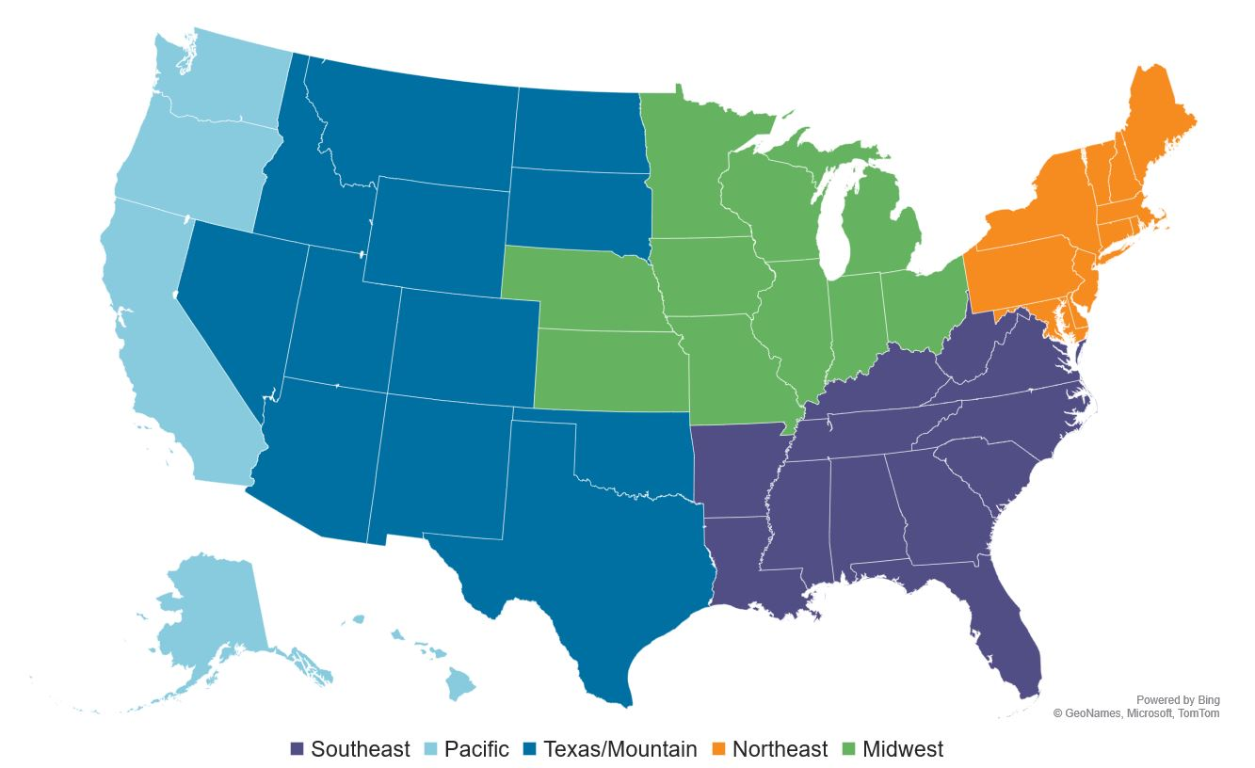
Divided the states into five regions of similar population
17%
21%
16%
21%
25%
Conference on
Innovations in Travel Analysis and Planning

Slide 19
By region of the US
Conference on
Innovations in Travel Analysis and Planning

Slide 20
By state (selected states)
2 lowest states
Conference on
Innovations in Travel Analysis and Planning

Slide 21
By PUMA population density quintile
Conference on
Innovations in Travel Analysis and Planning

Slide 22
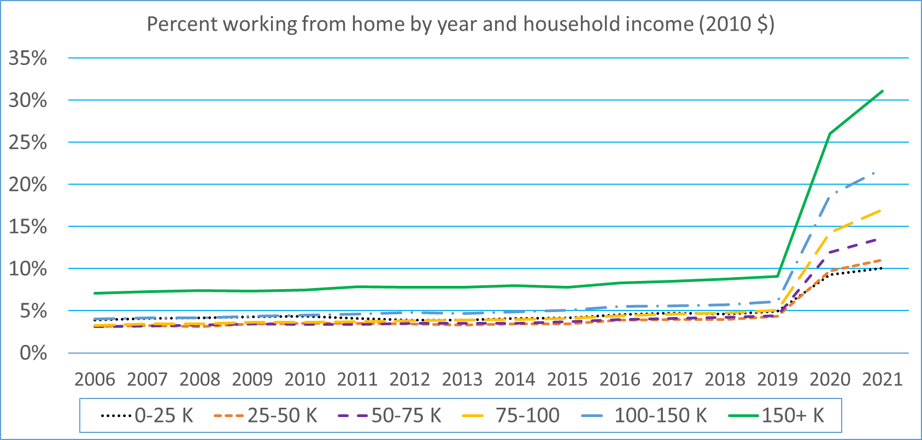
Summary of findings
The first two years of the pandemic accelerated a pre-existing trend in increased working from home.
Pre-COVID, telecommuting was most likely for self-employed, part-time, and older workers, and was a less urban phenomenon.
In 2020 and 2021, workers with higher incomes, higher education levels, and in the high tech and business service industries had the largest growth in telecommuting. Also a shift toward more urban areas.
Even after accounting for other factors, Black and Hispanic workers were less likely to work from home than other race/ethnicity groups.
Women are still more likely to work from home than men, particularly those with young children.
After accounting for other factors, working from home now decreases with age over age 45, reversing the pre-COVID trends with age.
Conference on
Innovations in Travel Analysis and Planning

